Slide 1

JMS Band
Click here for our MCS New to Band website
Gwen Rakoff
Band Director

Slide 2

Class Options
DMS Band
JMS Band
Beginner Band - Level 1
(no experience)
Concert Band - Level 2
(Previous band experience required)
Symphonic Band - Level 3
(Previous band experience, an audition and
private lessons are required)

Slide 3
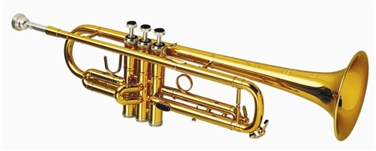
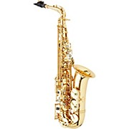
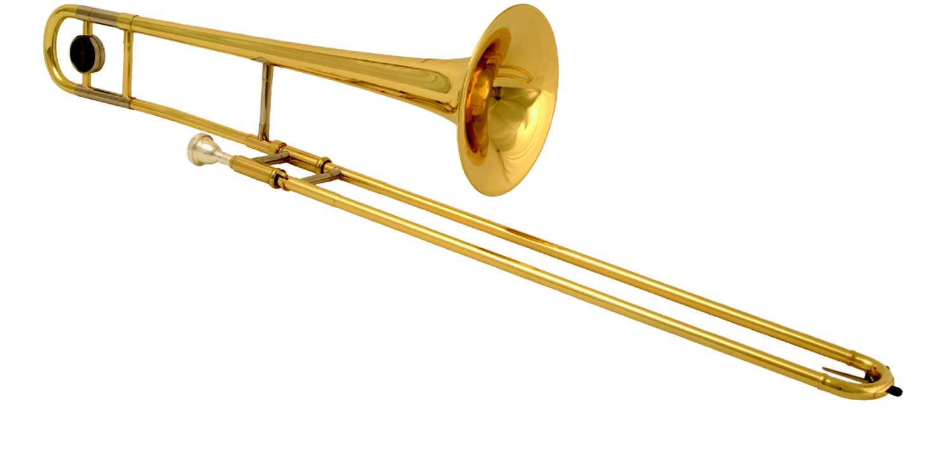
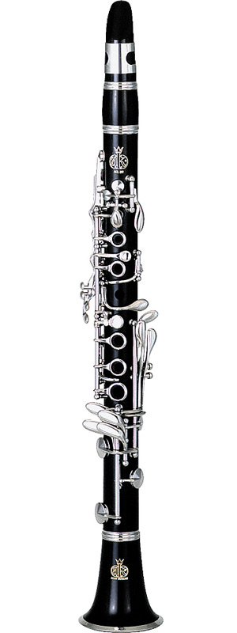
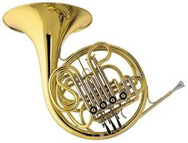
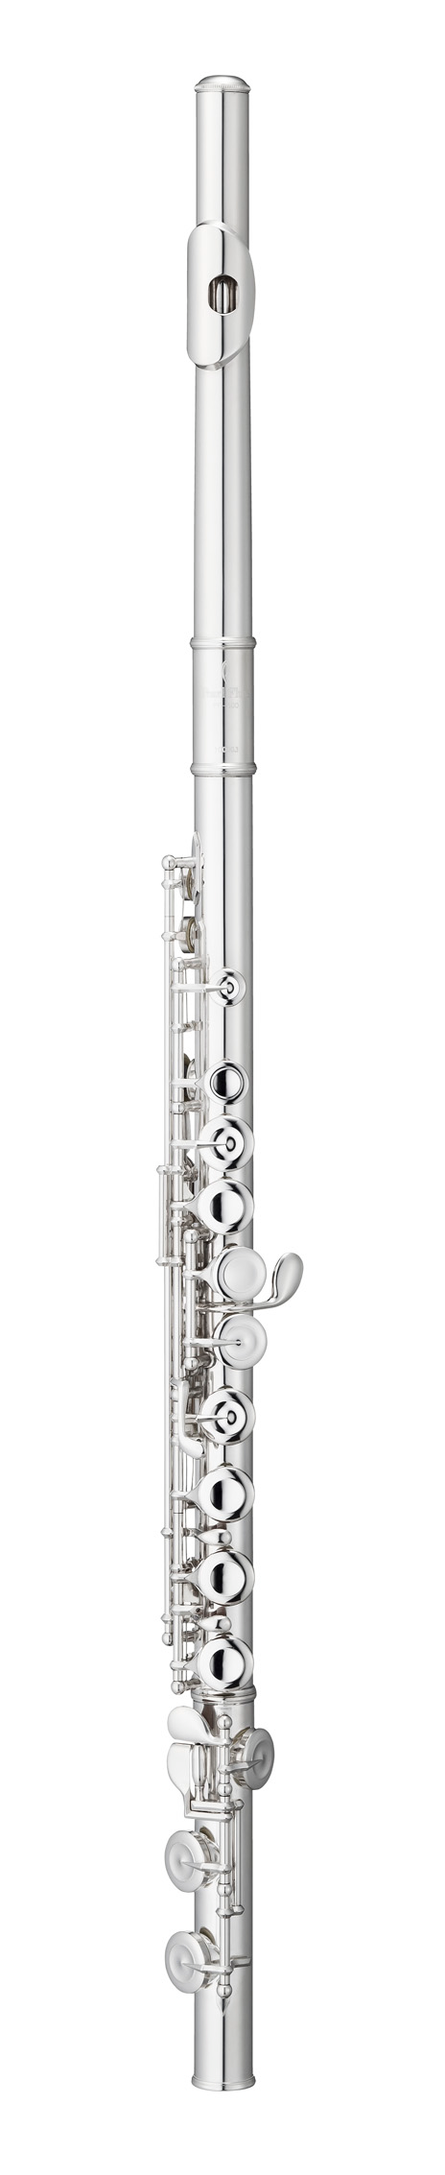
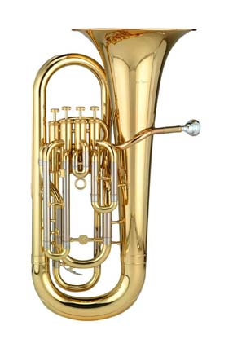
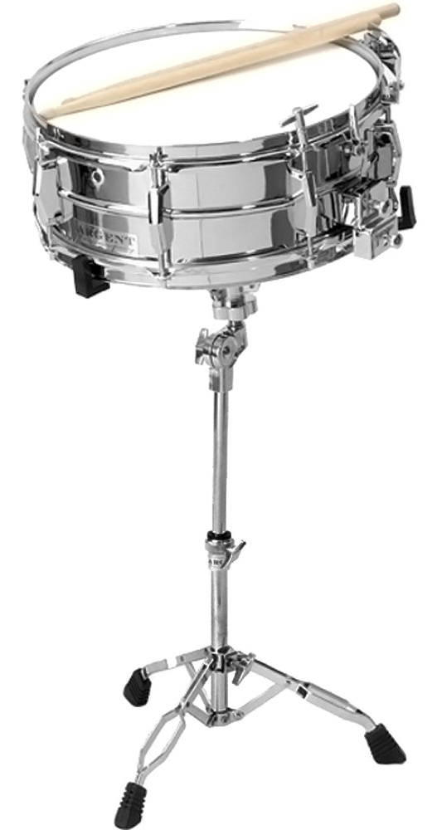
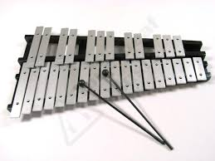
What Instruments Can I Learn when I Join Beginner Band?
Beginner Woodwind/Percussion Class:
Flute
Oboe
Clarinet
Alto Saxophone
Percussion
Beginner Brass Class:
Trumpet
Trombone
French Horn
Baritone
Tuba
Bassoon

Slide 4

Frequently Asked Questions:
Can I join Beginner Band as a 7th or an 8th grader?
Yes! Your grade level doesn’t matter! Beginner Band will be a mix of 6th, 7th and 8th grade students. 7th or 8th graders can only join Concert or Symphonic Band with at least 1 year of band experience.
Can I play piano or guitar in band?
Not in Beginner, Concert or Symphonic Band classes. But, you can play piano, electric guitar, or bass guitar in jazz band! Piano experience is also EXTREMELY useful for percussion! We require Jazz Band students to also be a member of Concert/Symphonic Band classes.

Slide 5

Frequently Asked Questions:
Can I play violin, viola, or cello (or any other string instrument) in band?
No, I’m afraid not. But again, the experience is very helpful! Come and talk with Mrs. Rakoff and see how to get involved. String Bass players can get involved in Symphonic Band, so please come speak with Mrs. Rakoff if you play String Bass!
I just want to play the snare drum only! Can I?
Nope. Sorry. Journey Middle School emphasizes the well-rounded percussionist. If you join band as a percussionist, you will learn the mallet instruments as well as the battery percussion like snare drum, bass drum, etc. You will rent (and play) both! Learning something new is part of the awesome band experience!

Slide 6
Frequently Asked Questions:
Does the band take trips?
YES! They are a ton of fun. We travel to compete or perform once a year. Possible trip destinations include Disney in Orlando, Dollywood in Gatlinburg, or Six Flags in Atlanta.
Band is too expensive. Is there a way to supplement my band fees?
There is ALWAYS a way for ANY student to join band! Please contact Mrs. Rakoff with questions or concerns you may have. We have many fundraiser options every year for those who want to contribute in that way.

Slide 7
How do I choose an Instrument?
JMS Bands hosts an “Instrument Petting Zoo” where students get to try all the instruments and see which one fits best! It’s important to know what you are more naturally inclined to play.
We are here to help you choose the right instrument!
Petting Zoo dates:
February 29 OR March 1
(in the JMS Band Room)

Slide 8


Journey Middle School Bands
Find us on the following platforms!
madisoncity.k12.al.us/journey
>Academics >Fine Arts >Band
Gwen Rakoff:
grakoff@madisoncity.k12.al.us

